Slide 1
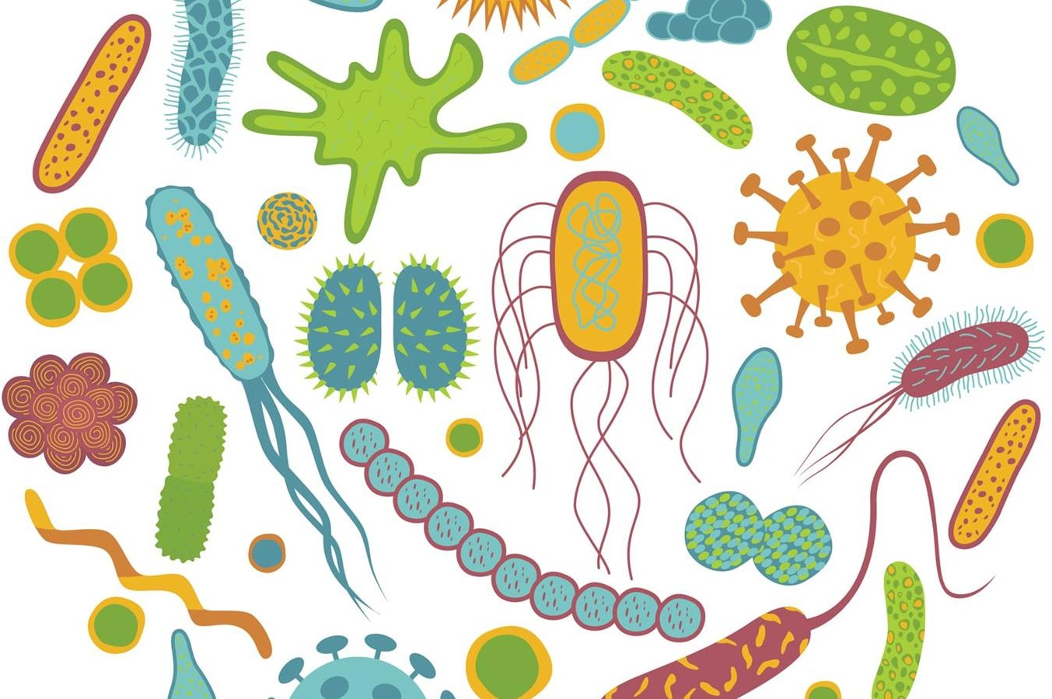
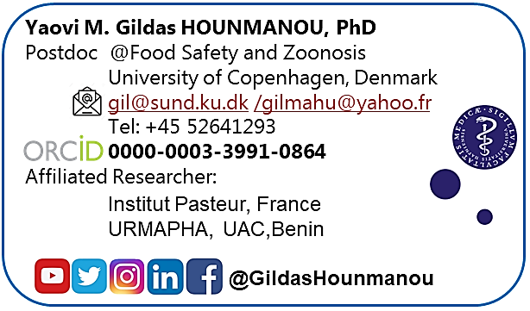
Microbiome et impact de l'antibiothérapie

Slide 2
Metagenomics for Microbial community analysis
Gildas Hounmanou, PhD
- Assistant Professor
@Food Safety and Zoonosis, University of Copenhagen, Denmark
- Research Fellow
@Microbial Genomics Section, National Institutes of Health, USA

Slide 3

Group reflection 1
What is the microbiome?
What is the microbiome made of ?
What is the role of the microbiome ?
What factors influence the microbiome composition?
Put your responses on the padlet reachable here:
tinyurl.com/gilmicro

Slide 4
Individual activity KAHOOT
Follow live instructions
KAHOOT.IT

Slide 5
Microbiome? 16S? Amplicon sequencing? Metagenomics?
Institut for Naturvidenskab og Miljø, RUC
Microbiome is microbial community
Amplicon sequencing - Microbiome studies of a group of organisms based on amplification and sequencing a 1 or more genes
16S rRNA gene amplicon sequencing is a type of amplicon sequencing
Metagenomics is “deep” and “random” sequencing of a large amount of DNA, producing high amounts of data to describe ALL organisms in a sample (The collective genome of all the microorganisms in an environment)

Slide 6
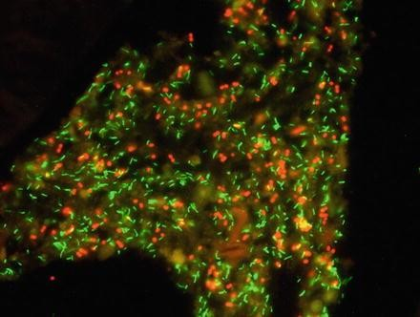
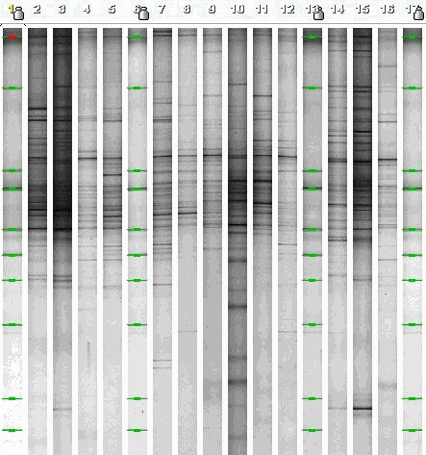
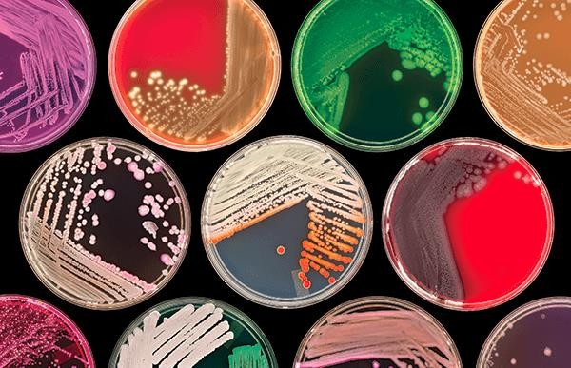
Ancient times
THEN
Institut for Naturvidenskab og Miljø, RUC

Slide 7
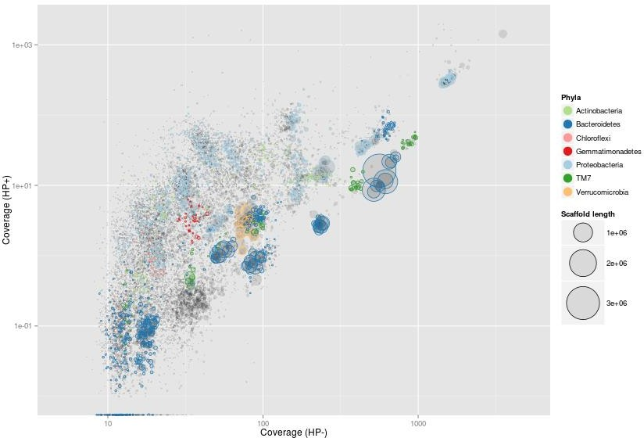
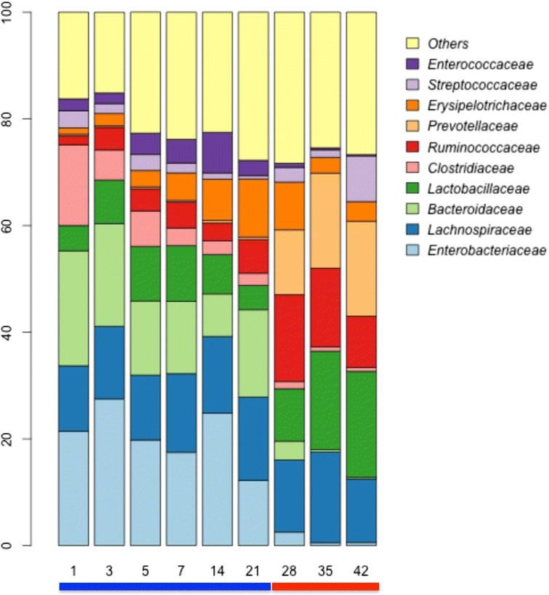
Present
NOW
Institut for Naturvidenskab og Miljø, RUC

Slide 8
What to choose?
Institut for Naturvidenskab og Miljø, RUC
Isolation and cultivation
Few bacteria can be easily grown
Often not the right bacteria that get isolated
Slow and labor intensive You see the bacteria
Old molecular methods
No isolation and cultivation needed
Most bacteria
Slow and labor intensive
You see/don’t see the bacteria
DNA Sequencing (amplicon sequencing)
No isolation and cultivation needed No microscopy needed
All bacteria
Fast and cheap (compared to the other technologies)
You don’t “see” the bacteria - Are they dead?

Slide 9

Microbiome sequencing with amplicon sequencing
16S
Institut for Naturvidenskab og Miljø, RUC

Slide 10


Metagenomics
Institut for Naturvidenskab og Miljø, RUC

Slide 11
Amplicon microbiome VS metagenome
Institut for Naturvidenskab og Miljø, RUC
Microbiome studies are becoming a new “golden standard”
Inexpensive
“Easy” to perform, both in the “wet” and “dry” lab
Needs little computer power
Fairly fast
Getting more and more accurate

Slide 12
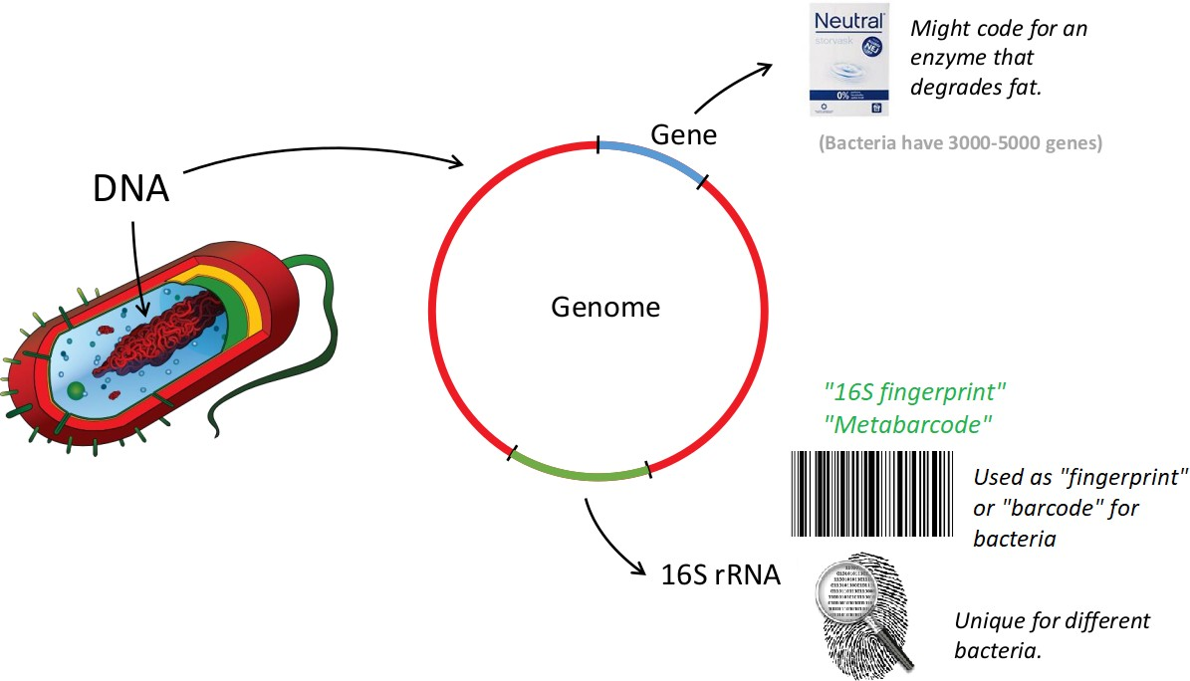
Amplicon sequencing (16S rRNA gene)
Institut for Naturvidenskab og Miljø, RUC

Slide 13




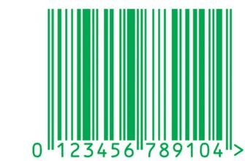


Amplicon sequencing (16S rRNA gene)
Institut for Naturvidenskab og Miljø, RUC
18

Slide 14
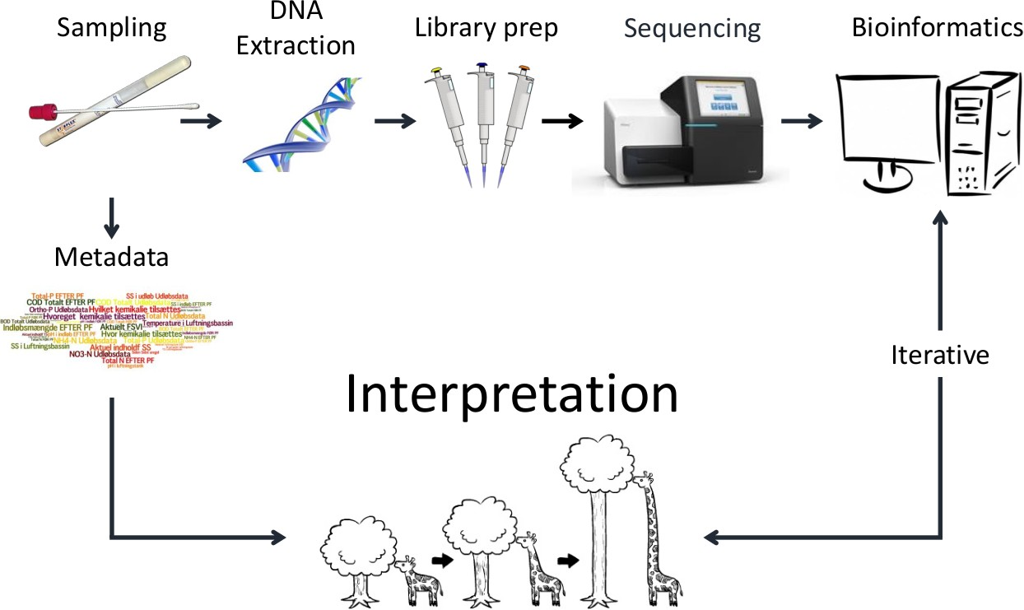
Workflow for identification of microbes by sequencing
Institut for Naturvidenskab og Miljø, RUC

Slide 15



Institut for Naturvidenskab og Miljø, RUC
Reality
Illumina
Nanopore

Slide 16
16S rRNA gene sequencing
16S rRNA is part of the 30S subunit of the ribosome in prokaryotes (+proteins).
Encoded by 16S rRNA gene.
Why is it good for bacterial community profiles?
Highly conserved regions → primer design
Hypervariable regions → faster in evolution
Is it the only option?
Pasteurellaceae rpoA/B, recN
Staphylococci tuf
MLST systems (multi-locus sequence typing)
etc.

Slide 17
But you could be looking for something else
speciation common staphylococcal pathogens
CoNs
Vs.
S. aureus
S. aureus Vs.
S. epidermidis
Illumina recommends targeting regions that result in an amplicon that when sequenced with paired-end reads has at least ~50 bp of overlapping sequence in the middle. For example, if running 2x300 bp paired-end reads, Illumina recommends a size of 550 bp or smaller.
Chakravorty et al. 2007, JMM, Wang and Qian, 2009, PLoS one, Qin et al. 2012, Nature

Slide 18
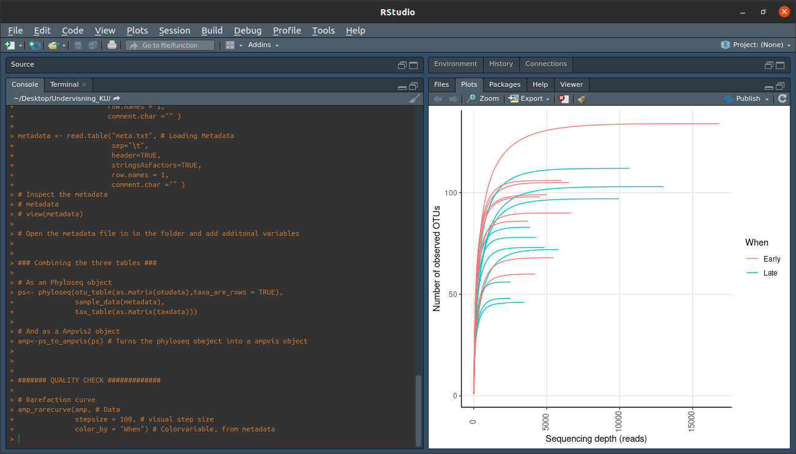
38

Slide 19
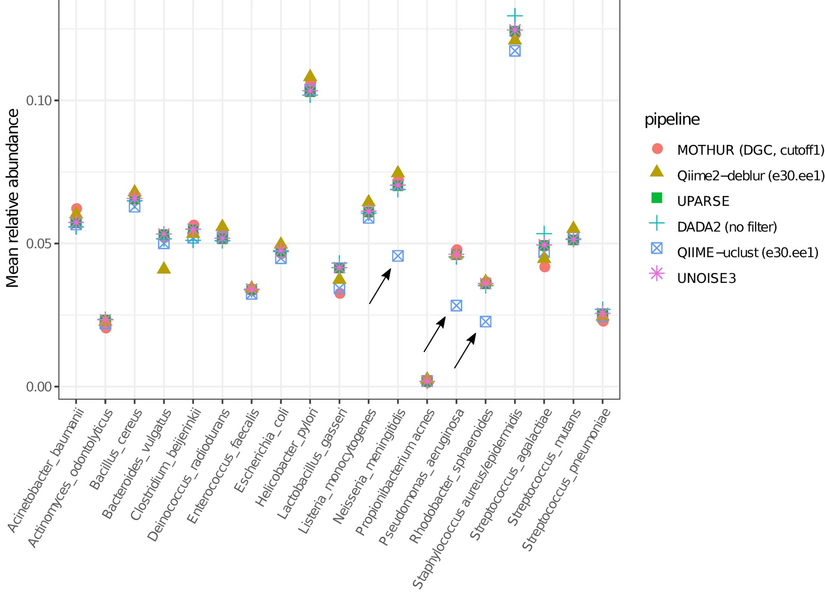
pipelines
OTU pipelines
QIIME-uclust
MOTHUR
USEARCH-UPARSE
ASV pipelines
DADA2
Qiime2-Deblur
USEARCH-UNOISE3
Prodan A, Tremaroli V, Brolin H, Zwinderman AH, Nieuwdorp M, Levin E. Comparing bioinformatic pipelines for microbial 16S rRNA amplicon sequencing. 2020. https://doi.org/10.1371/journal.pone.0227434

Slide 20
pipelines
Filtering, dereplication, sample inference, chimera identification, and merging of paired-end reads: DADA2
https://benjjneb.github.io/dada2/tutorial.html
Differential abundance: DeSeq2
Diversity, ordination plots, Adonis (permanova significance test for group-level differences): phyloseq, vegan
1.0
site
BAL
bronchial.tissue
0.5
nasal.concha
nostril
Axis.2 [13.5%]
sinus
tonsil trachea
pig
0.0
46129.66
46132.67
F.1.1.9
F.1.3.29
F.1.3.35
F.1.4.36
−0.5
−1.0
−0.5
0.0
Axis.1 [23%]
0.5
1.0

Slide 21
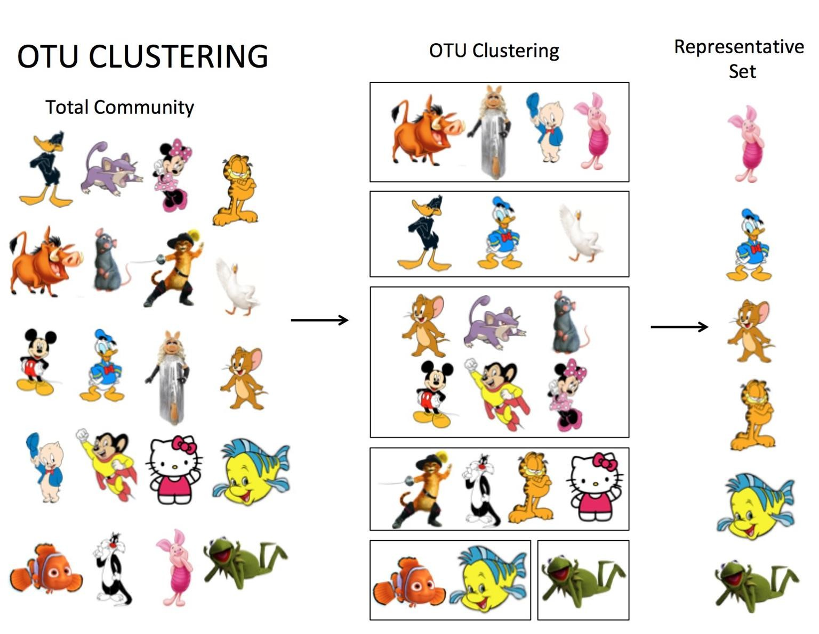
ASV vs OTU
Institut for Naturvidenskab og Miljø, RUC
Operational Taxonomic Units
Are clustered together based on a (traditionally) 97% similarity threshold.
Amplicon Sequence Variant can resolve
sequences that differ by a single nucleotide.
ASVs are also referred to as exact sequence variants (ESVs)

Slide 22
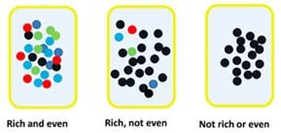
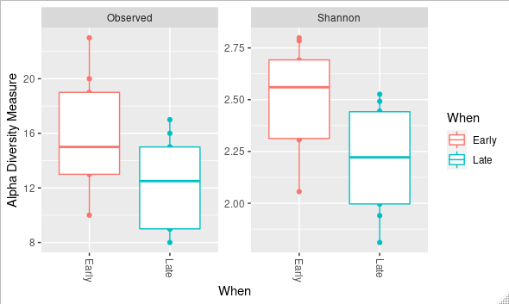
Alpha diversity
Institut for Naturvidenskab og Miljø, RUC
Diversity within a sample
Richness - richness is not equal to diverse!
Evenness
No of OTUs Shannon Chao1 Simpson Evenness

Slide 23
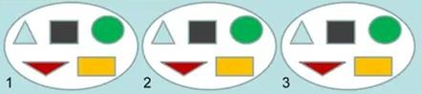

Gamma- and Beta diversity
Institut for Naturvidenskab og Miljø, RUC
Alpha diversity within a sample
Gamma- and Beta diversity in between multiple samples
⍺ = 5 OTUs in each sample
γ = 5 OTUs in between all samples
β = 1 “community type”
⍺ = 5 OTUs in each sample
γ = 15 OTUs in between all samples
β = 3 “community type”
52

Slide 24
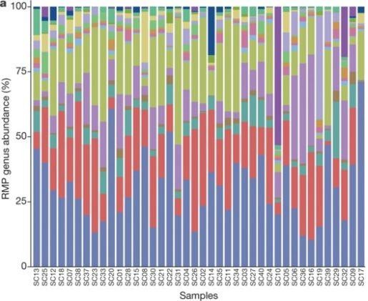
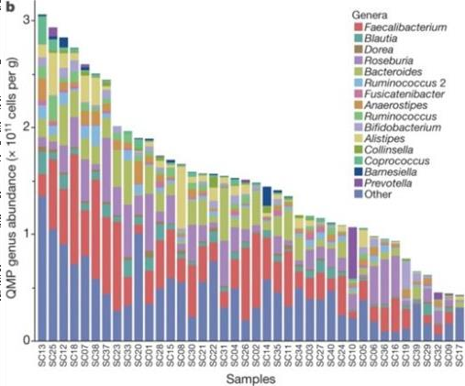
Who’s there? And how many?
Institut for Naturvidenskab og Miljø, RUC

Slide 25
Group reflection 2.
You are involved in a national AMR project to propose a study to reduce antimicrobial use in food animals
What is the contribution of AMU in animal in the increase of AMR in humans
How does antimicrobial treatment affect microbiome ?
What kind of data would you collect in your project to significantly impact antimicrobial use on farms
Make sure your proposed ideas are cost-effective, sustainable and acceptable to farmers
What alternatives have better influence on microbiome and also good for farmers?
Put your responses on the padlet reachable here:
https://padlet.com/gil114/h4o0t4bumyjavg99

Slide 26

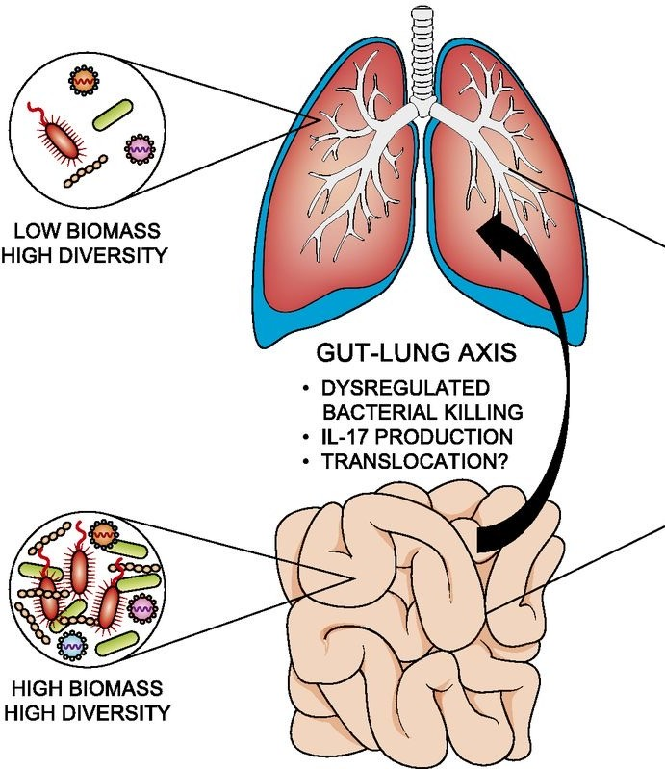
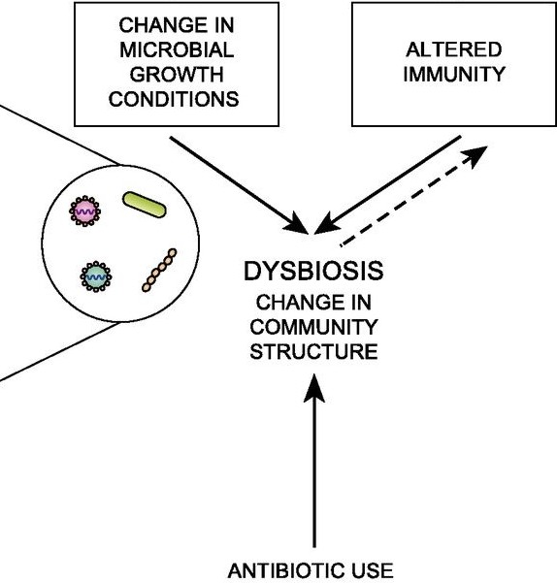
The microbiome in homeostasis
Microbiota functions:
Digestion / feed conversion
energy metabolism
inflammation
modulates multiple endocrine, neural, and immune pathways of the host
Antibiotic use
O’Dwyer D N, Dickson R P, Moore BB. The Lung Microbiome, Immunity, and the Pathogenesis of Chronic Lung Disease. J Immunol 2016. DOI:https://doi.org/10.4049/jimmunol.1600279

Slide 27
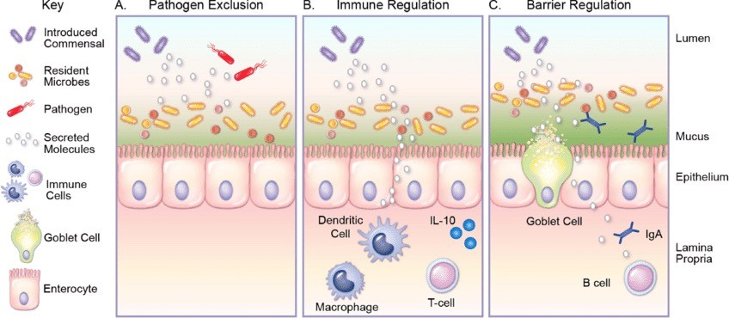
Commensal microbiota
Protect against infections through:
Competition for nutrients, space, binding sites
indirect immune-mediated effects
direct antimicrobial effects
Engevik M A, Versalovic J. Biochemical Features of Beneficial Microbes: Foundations for Therapeutic Microbiology. DOI:10.1128/microbiolspec.BAD-0012-2016

Slide 28
Antimicrobials
Selectively kill bacteria (spectrum)
Including taxa that protect against infections.
E.g. Anaerobes (especially Firmicutes/Actinobacteria) seem important antagonists of specific infections.
Select resistant organisms (competitive advantage)
Intrinsically resistant → favour some species
Organisms that have acquired resistance → favours spread of resistance
Promote:
Horizontal gene transfer of resistance determinants
Development of protective forms (e.g. sporulation in C. difficile)

Slide 29


